Slide 1
CI - Letter Recognition
Machine Learning Project
By-Sudeep Raj

Slide 2
1. Problem Statement
2. EDA
3. Model Training and Prediction
4. Conclusion
AGENDA

Slide 3

Problem Statement
The objective is to identify each of a large number of black-and-white rectangular pixel displays as one of the 26 capital letters in the English alphabet.

Slide 4
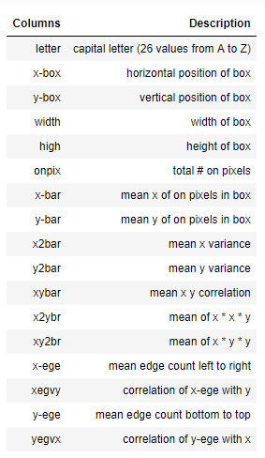
(16000 x 18)
Train dataset: 16000 records
(3999 x 17)
Test dataset: 3999 records
Prediction : letter

Slide 5
Model Training and Prediction
Random Forest Classifier
KNN
XGBoost
Support Vector Classifier
Ensemble Learning

Slide 6
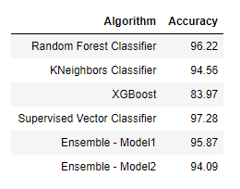
Accuracy Table

Slide 7
Conclusion
Trained and predicted the letters with test dataset.
SVC provides the maximum accuracy and Random Forest being the second.
Comparing the output file and calculated the difference, 3825 records predicted correctly from 3999 when we compare SVC model as reference.

Slide 8
Thank You !!!

